Slide 1
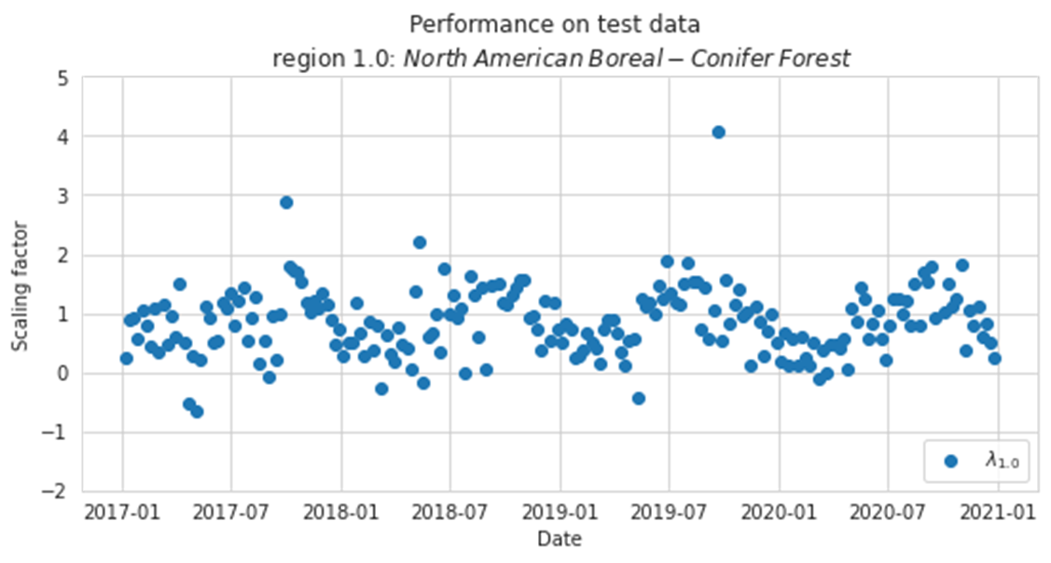




A Machine Learning Approach to Propagating the State Vector in a CO₂ Data Assimilation Approach
Carbon cycle
By Ritten Roothaert
Supervisors:
Auke M. van der Woude (, MSc.)^{2,1}
Prof. Dr. Wouter Peters^{1,2}
Dr. Celestine P. Lawrence²
Time →
¹University of Wageningen, The Netherlands
²University of Groningen, The Netherlands

Slide 2
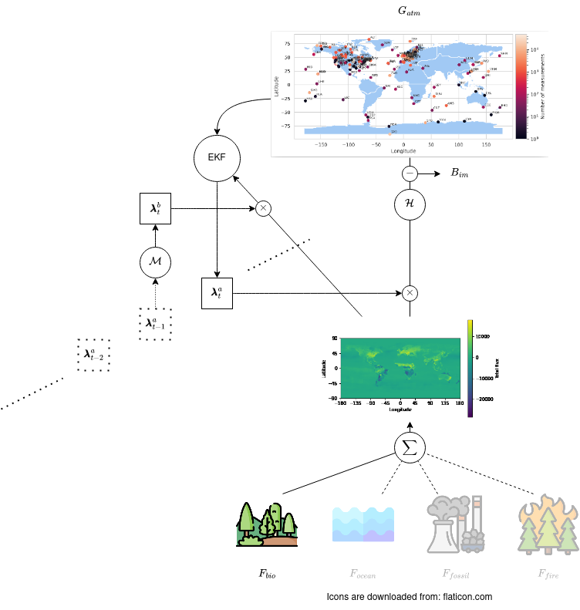
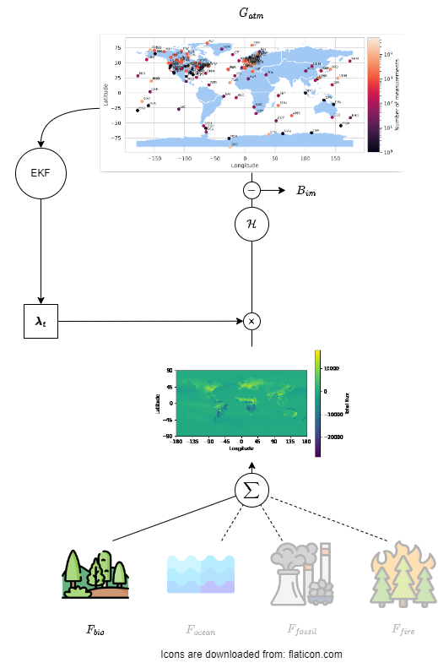
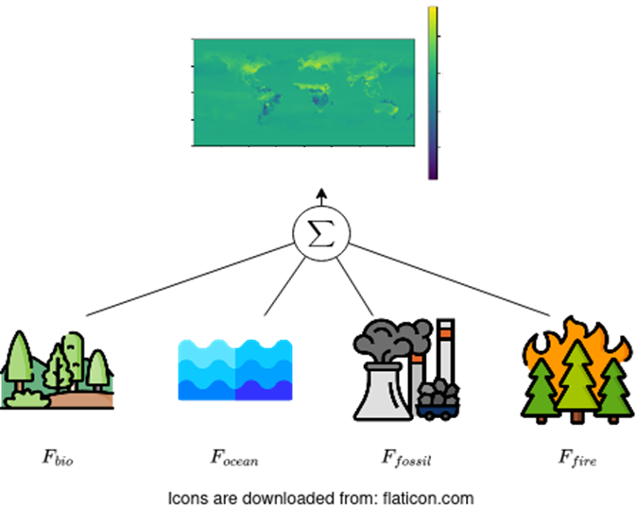
Content
Introduction
Background
Atmospheric inversion
Problem description
Missing transition function
General idea for improvement
Methods
Implemented models
Model evaluation
Results and discussion

Slide 3
Background information
Let’s start with some

Slide 4
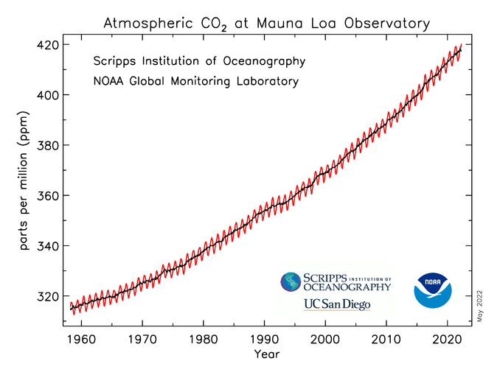
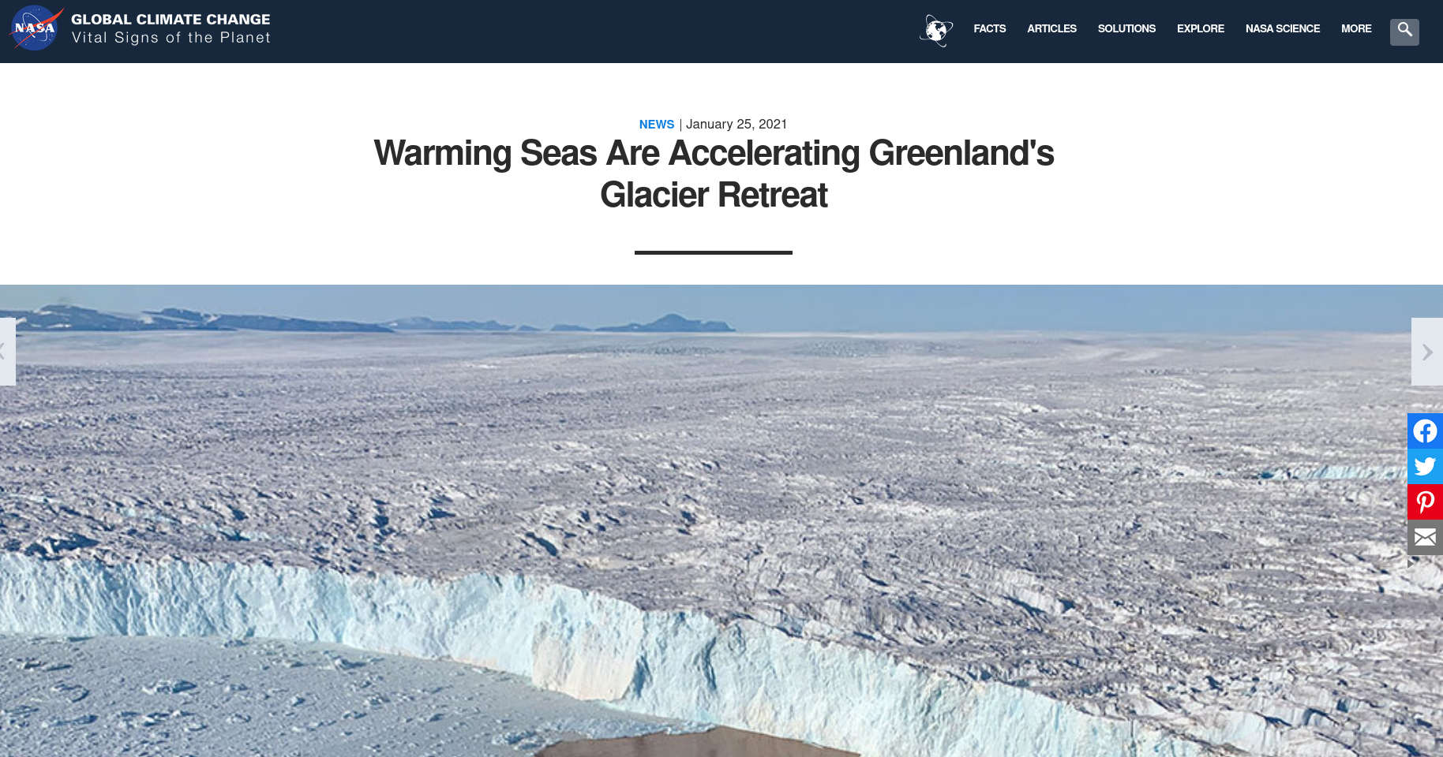
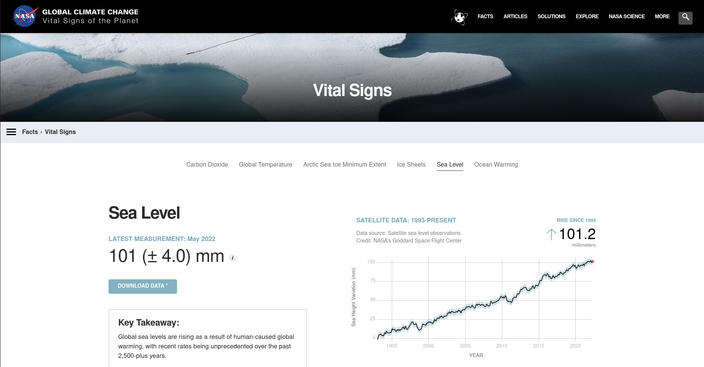
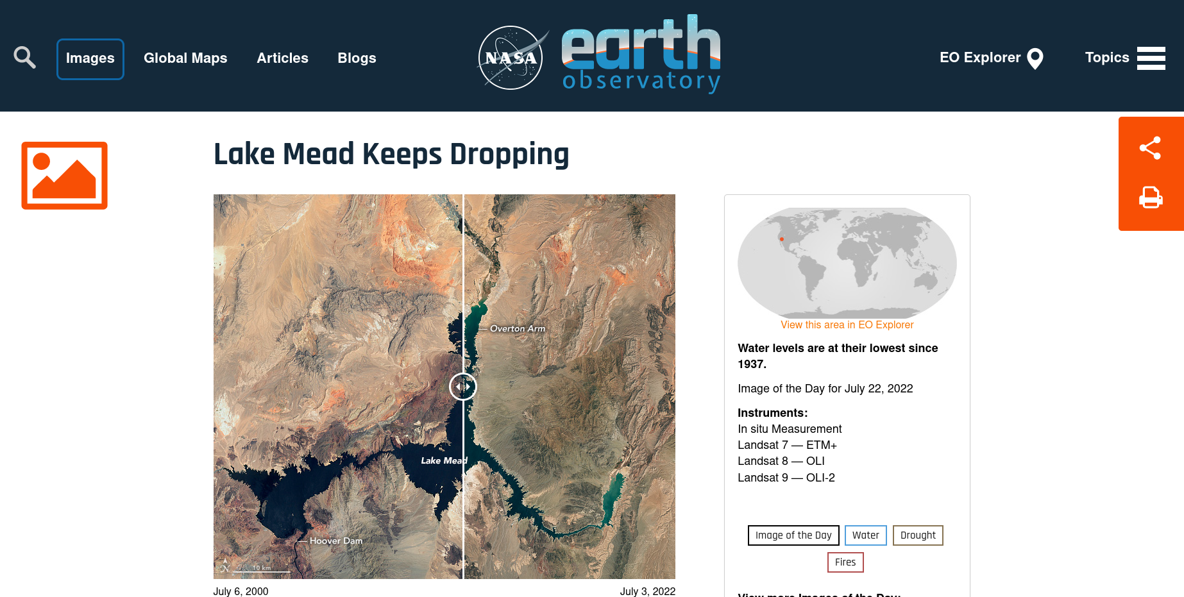
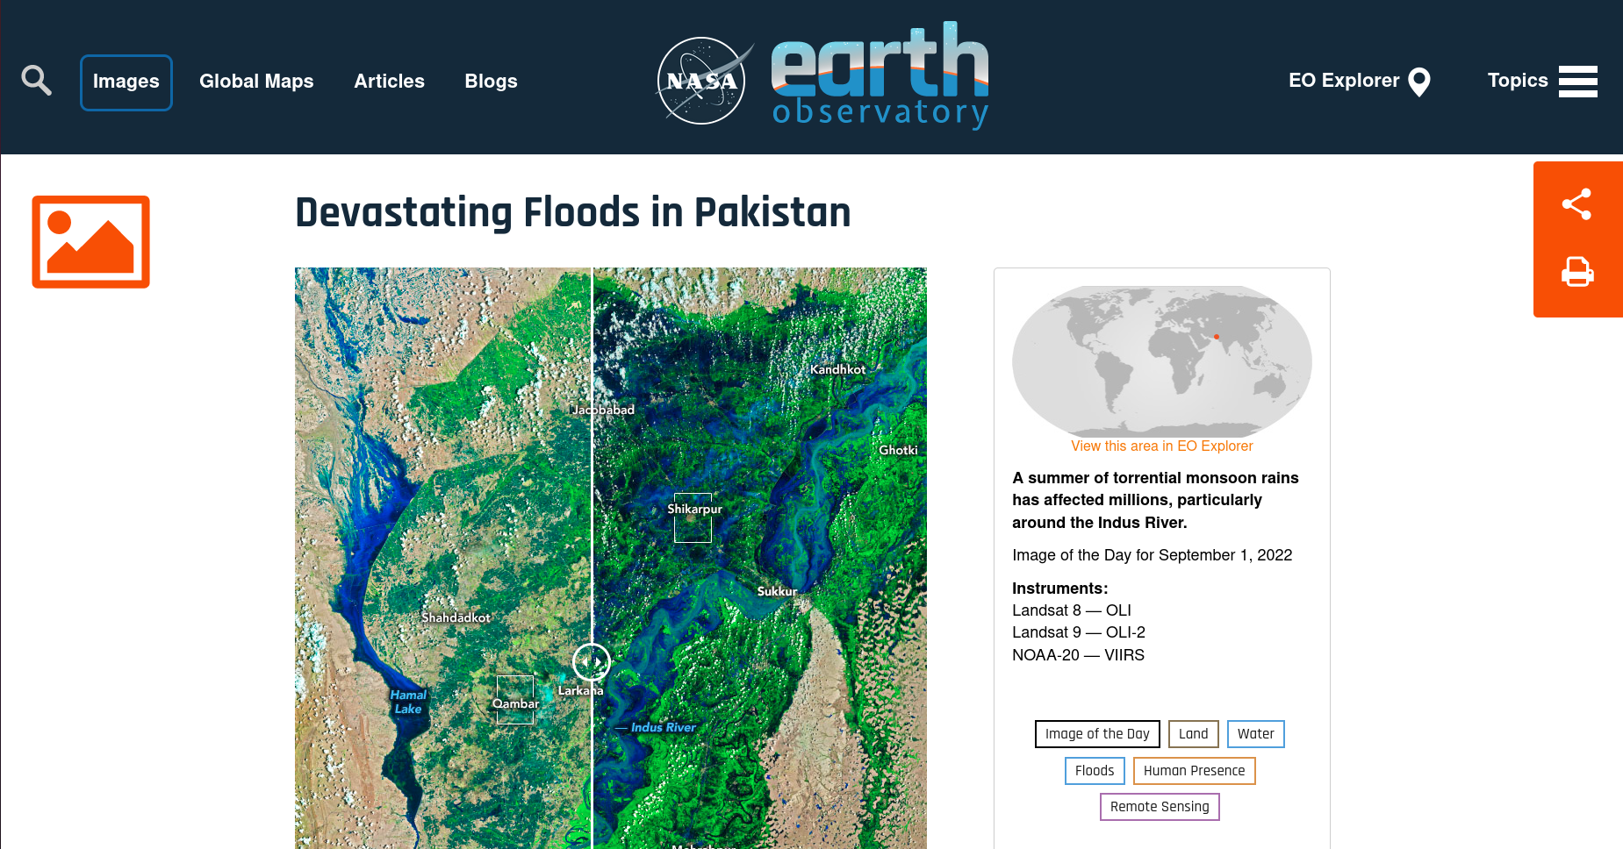
Background
Due to anthropogenic carbon emissions, atmospheric CO₂ are increasing
More severe droughts
Periods of heavier precipitation
Increase rate of glacial melting
Rising sea levels
Notes:
The first guy to report the increase in CO2 concentrations Charles D. Keeling
Lowest water point since april 1937, only 1 year after opening of Hoover dam
Worst floods in Pakistan within a decade, more than 1 million damaged houses
Intensified by increased rate of melting glaciers
Melting of all glaciers could result in a sea level rise of 60 meters
Sealevel rise further increased by thermal expansion of water

Slide 5

“[..] work with the international science community to establish a common and mutually agreed knowledge base to support policy debate and action to slow down and ultimately stop the increase of greenhouse gases in the atmosphere.”^{[6]}

Slide 6
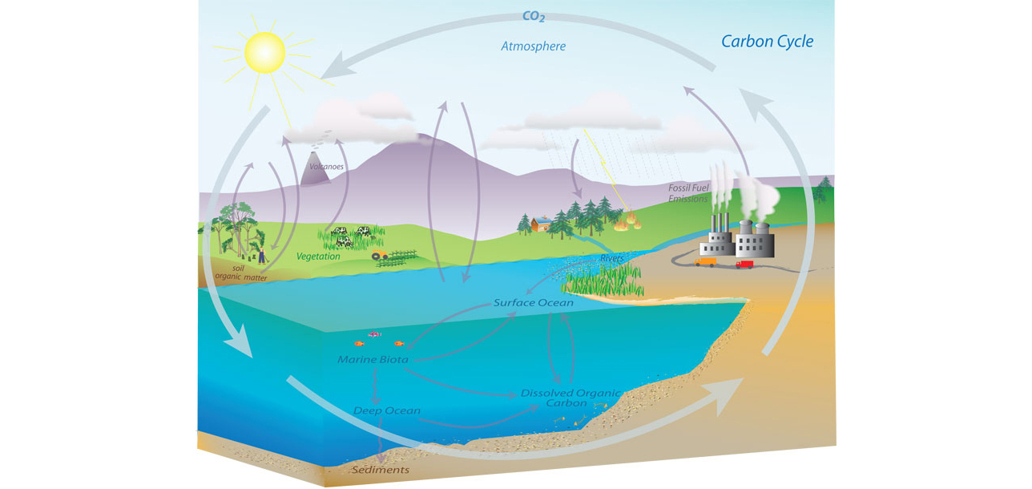
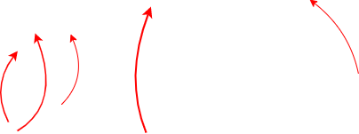
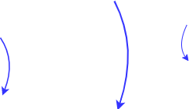
Delicate balance of the carbon cycle
Balance between various carbon sinks:
Forests
Oceans
Peatlands
…
And sources:
Anthropogenic emissions
Forest fires
…
Source: https://www.noaa.gov/education/resource-collections/climate/carbon-cycle
Notes:
Carbon sources: Land-use-change, fossil-fuel emissions
Carbon sinks: Forests, oceans, peatland

Slide 7
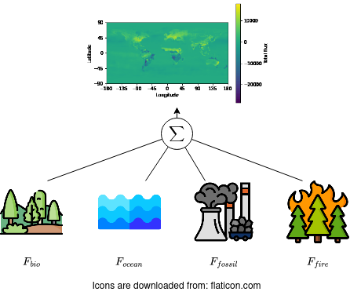
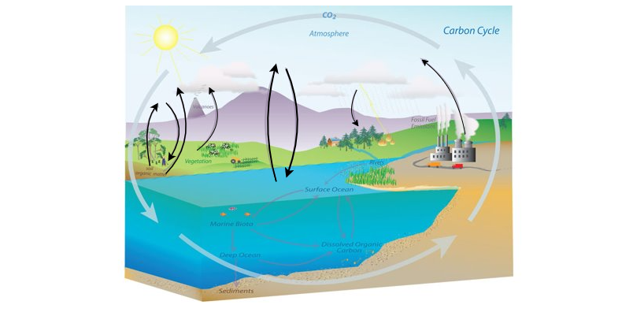
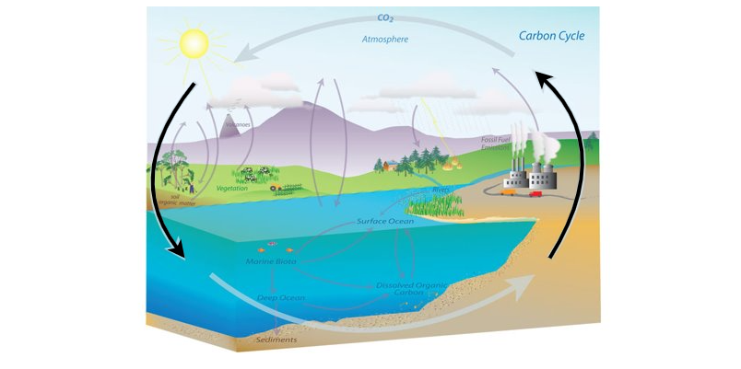
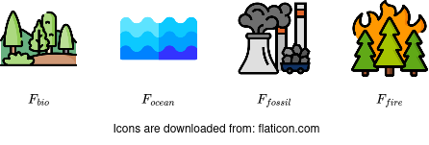
Bottom up approach
= Global carbon budget (GCB)^{[1]}
= Flux models

Slide 8
Bottom up approach

Slide 9
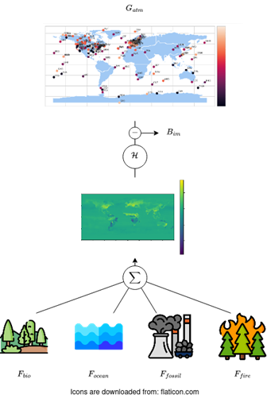
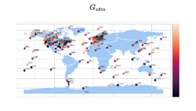

Budget imbalance
Bottom up approach
= Atmospheric gain
= Budget imbalance
= GCB
= Flux models

Slide 10
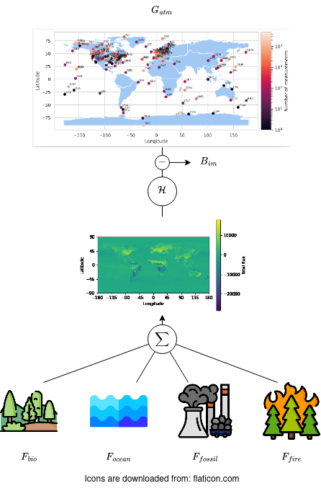
Top down approach

Slide 11
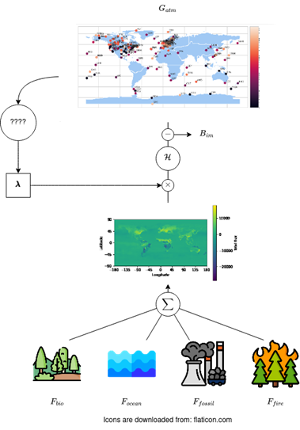
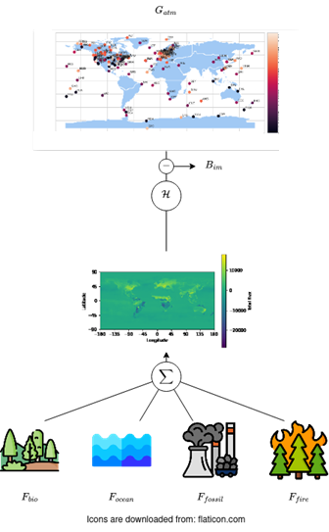
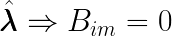
Top down approach
Atmospheric inversion
= Atmospheric gain
= Budget imbalance
= GCB
= Flux models

Slide 12
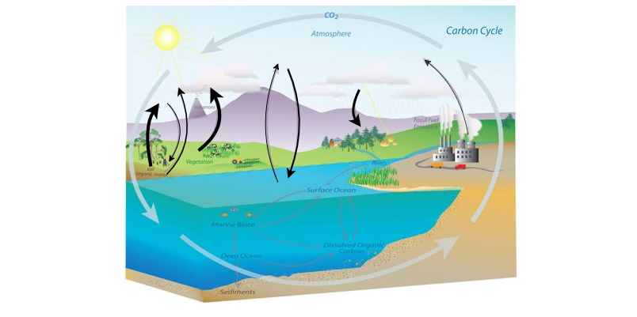



Relation to the carbon cycle
Every element in is a scaling factor of one of the arrows within the carbon cycle
A value >1 results in a large flux
A value <1 reduces the flux
Source: https://www.noaa.gov/education/resource-collections/climate/carbon-cycle
Notes:
Carbon sources: Land-use-change, fossil-fuel emissions
Carbon sinks: Forests, oceans, peatland

Slide 13
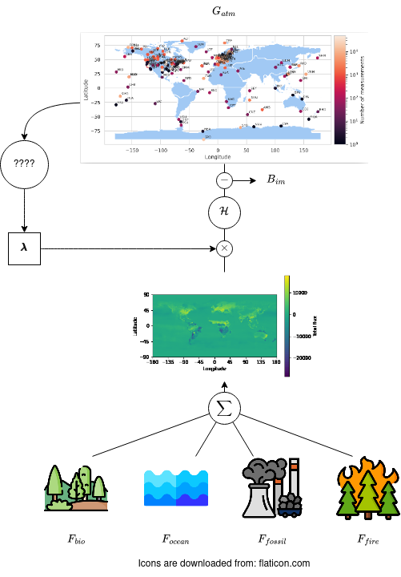
Process of atmospheric inversion
= Atmospheric gain
= Budget imbalance
= GCB
= Flux models

Slide 14
Prior flux models
Highest variability due to seasonal and diurnal effects. Difficult to model
Low variability, but very large carbon sink. Large impact on overall carbon cycle
Inventory on self-reported energy consumption statistics. Not always accurate, but low variability from the modelled trend and can be controlled
Based on burned biomass. Can be verified using satellite measurements and is thus considered to be reasonably accurate.

Slide 15
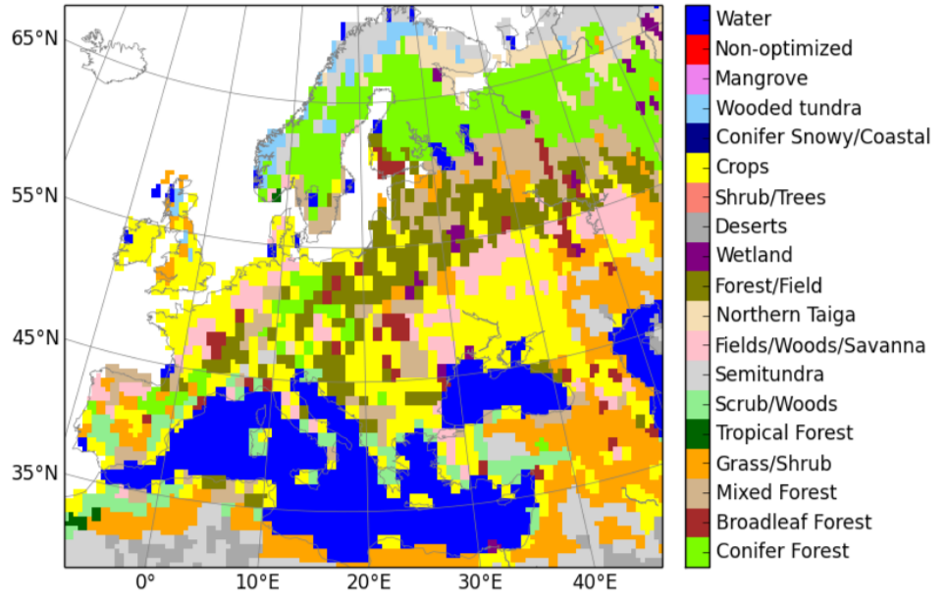
Biosphere model
Fluxes are based on the type of vegetation most dominant on a 1x1 degree grid cell
19 different plant functional types (PFTs) are defined (based on [3])
Not all PFTs exist in every region (i.e. no mangrove in Europe)
Source: https://carbontracker.eu/documentation_cte2018.pdf

Slide 16
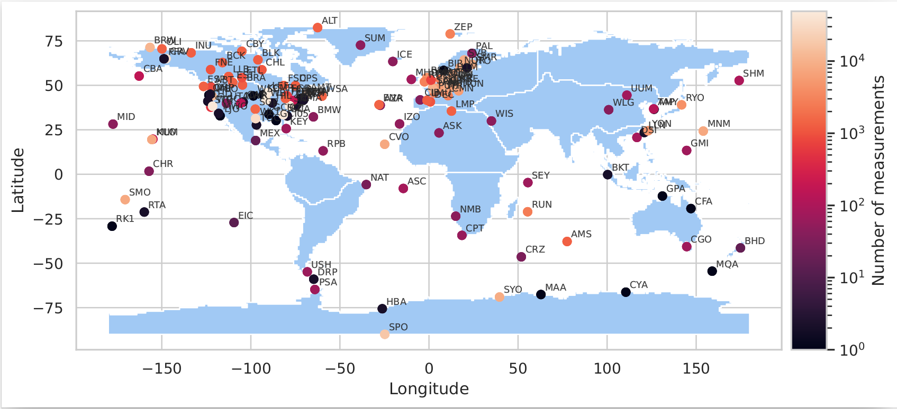
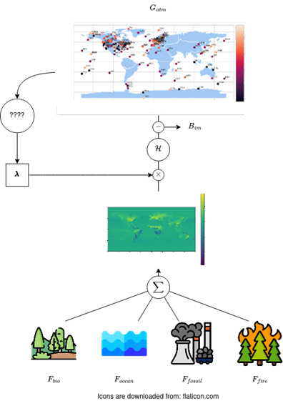
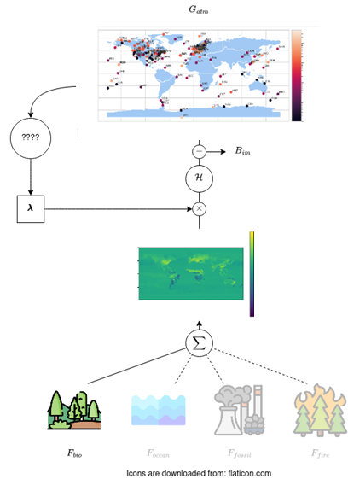
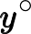
Atmospheric inversion
Totals:
- 147 stations
- 617090 measurements
= Atmospheric gain
= Budget imbalance
= GCB
= Flux models

Slide 17
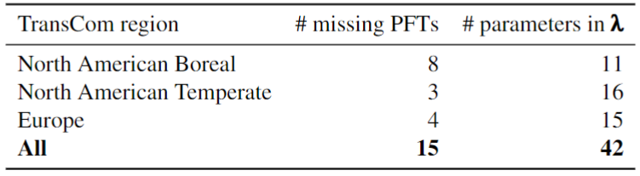
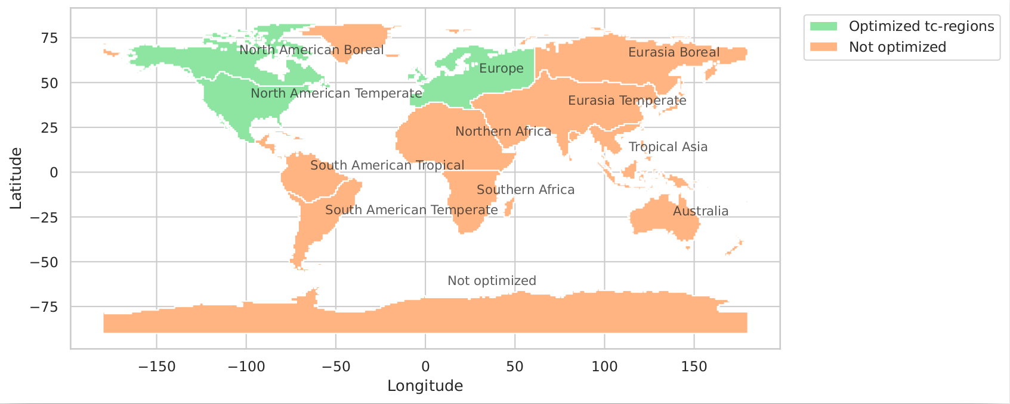
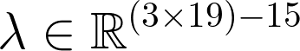
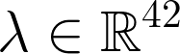
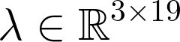
State-vector
Fluxes are based on the plant function type (PFT) most dominant on a 1x1 degree grid cell
TransCom region: Gurney et al. (2003) [2] - PFT: see Olson (1992) [3]

Slide 18
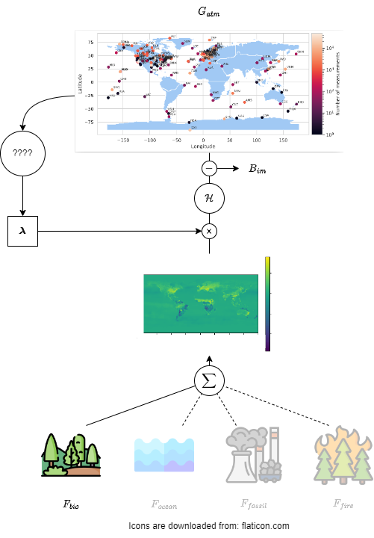
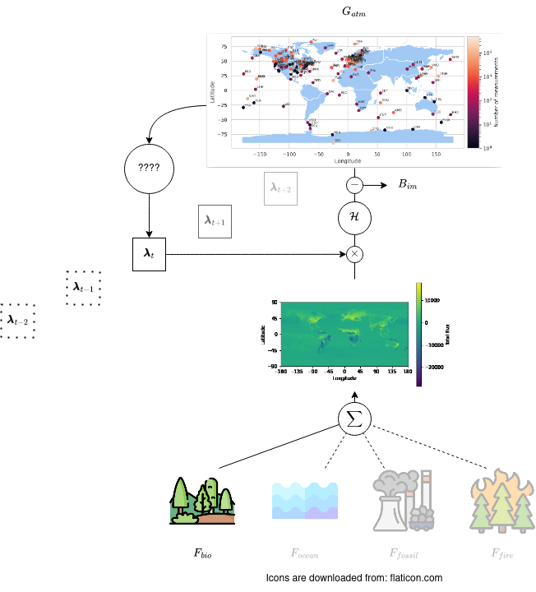

Atmospheric inversion
= Atmospheric gain
= Budget imbalance
Time in weeks →
= GCB
= Flux models

Slide 19
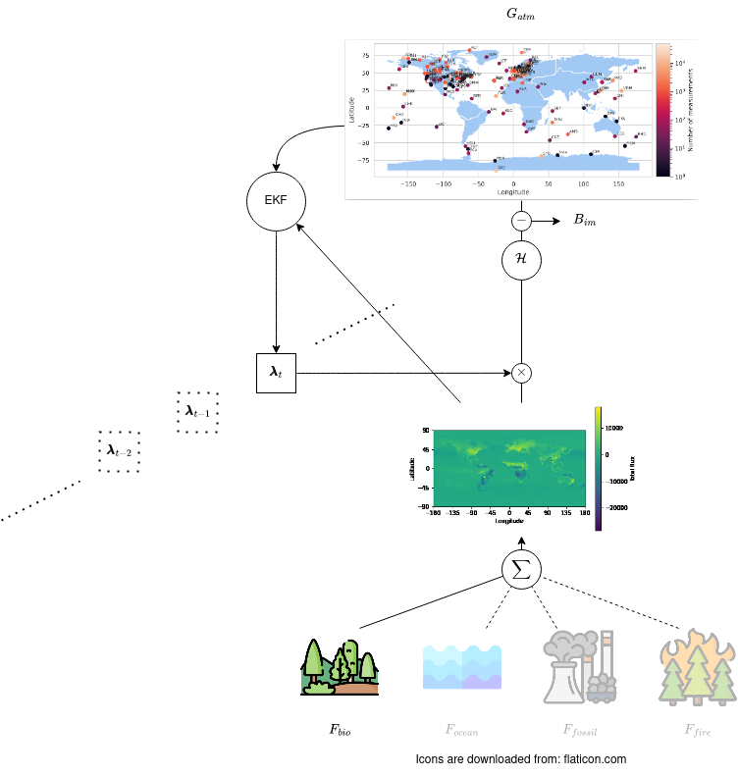
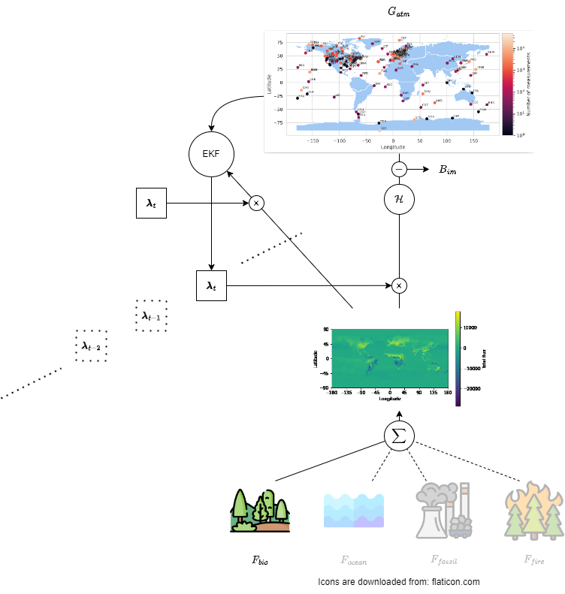


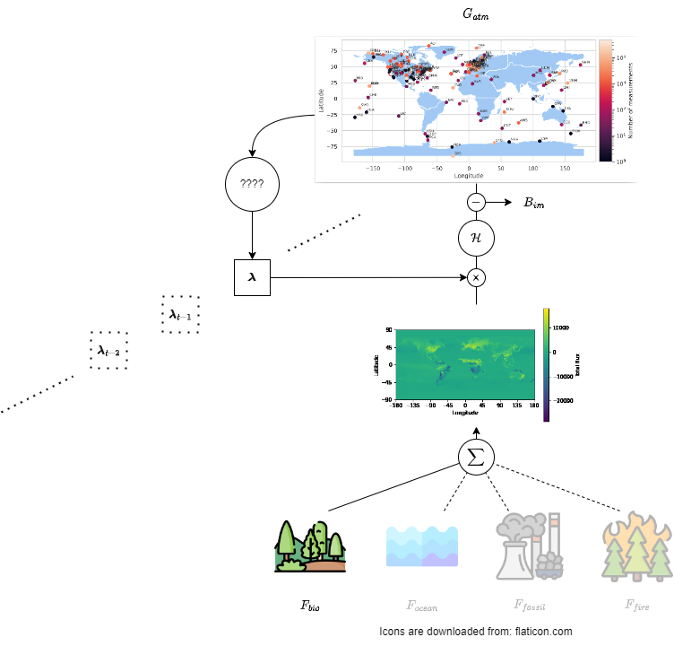
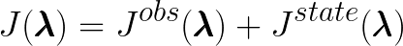
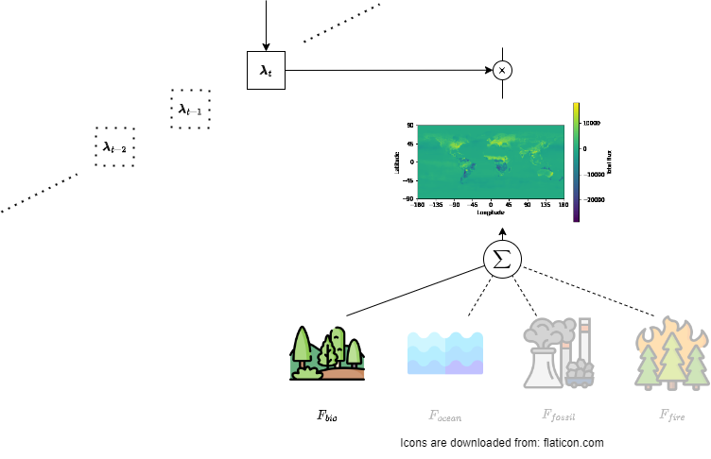
Atmospheric inversion
Ensemble Kalman filter (EKF)
Background statevector
“prior”
= Budget imbalance
Analyzed statevector
“posterior”
Time in weeks →
= GCB

Slide 20
Atmospheric inversion
Ensemble Kalman filter (EKF)
Time in weeks →

Slide 21
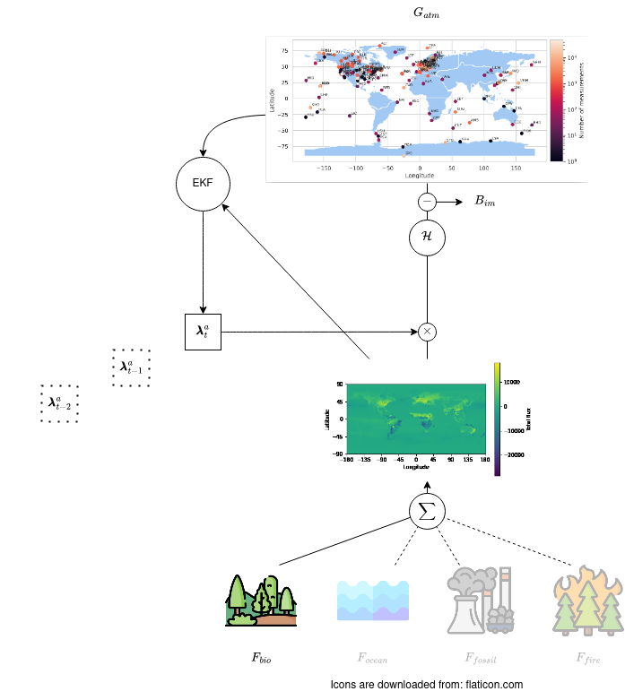

Atmospheric inversion

Slide 22

Atmospheric inversion
Ensemble Kalman filter^{[4]} →

Slide 23
Background statevector
“prior”
Analyzed statevector
“posterior”

Slide 24
Problem description
It is finally time for the

Slide 25
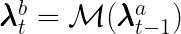
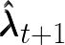
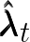
Missing transition function
The EKF needs a transition function:
Problem: does not directly depend on
depends on environmental conditions between and

Slide 26
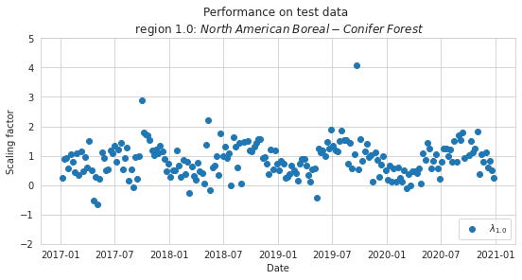
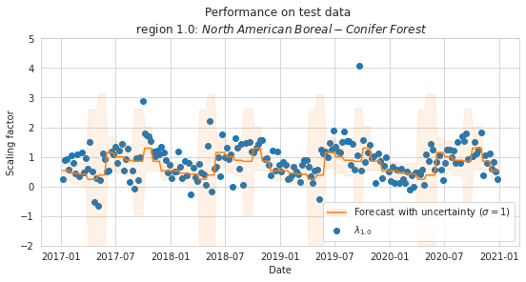
Seasonal pattern within scaling factors
4 years of testing data
Mean scaling factor per month
17 years of training data

Slide 27
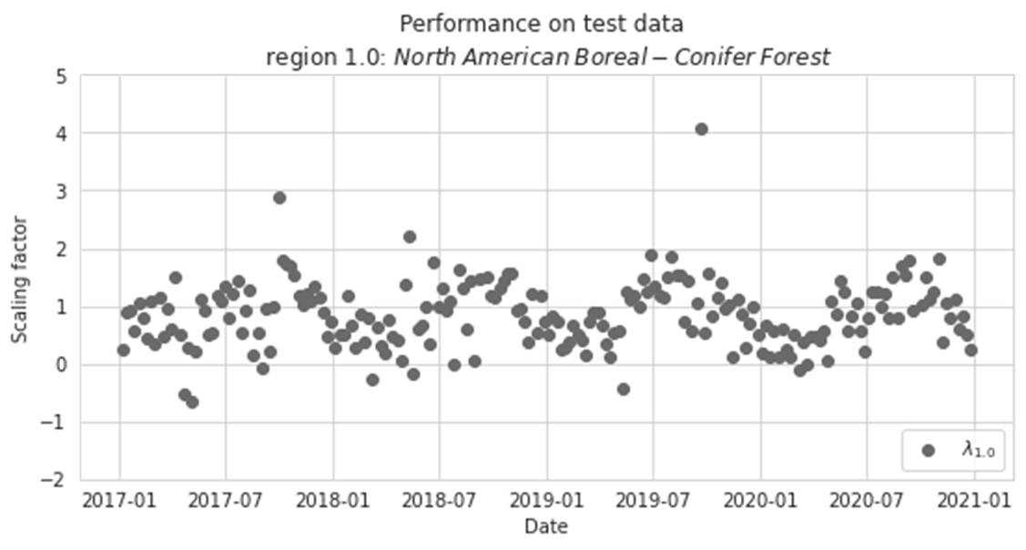
Seasonal patterns results in a predictable change in flux
= single flux in biosphere
Notes:
Carbon sources: Land-use-change, fossil-fuel emissions
Carbon sinks: Forests, oceans, peatland

Slide 28
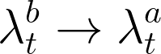





Idea: learn the transition function!
= Budget imbalance
Goal:
Target
= GCB
Training data

Slide 29
Idea: learn the transition function!
Available data
Potential problems
Several terabytes of exogenous variables
Over 5000 variables of which at least 185 are on sufficient spatial and temporal resolution
Model evaluation
Feature selection

Slide 30
Additional focus points
Main goal is bias reduction, followed by accuracy on lower scales
Indication on amount of training data needed to train the statevector prediction model

Slide 31
Methods - used models

Slide 32
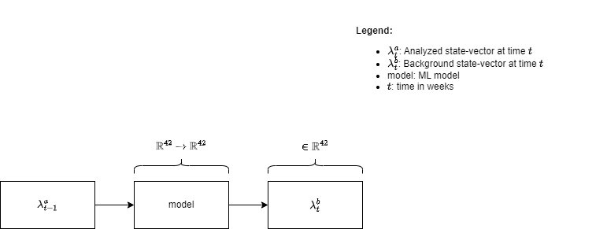



Desired behavior

Slide 33


Current implementation: smoother

Slide 34


Monthly mean model
=
=

Slide 35

SARIMA model implementation
SARIMA-parameters found using Box-Jenkin method^{[8]}
Optimization method based on MLE using a Kalman filter

Slide 36

SARIMAX
Same hyper parameters as SARIMA
Uses a single exogenous variable

Slide 37
Methods – Model evaluation

Slide 38


Problem 1: Model evaluation

Slide 39

Problem 1: Model evaluation
Flux space
=
State-vector space
=
Good performance in observation space does not entail good performance in state-vector space

Slide 40
Problem 2: feature selection
ECMWF dataset: Over 5000 variables, of which at least 185 variables on 0.25X0.25 grid cells
Anomalies in net ecosystem exchange (NEE) are correlated with anomalies in temperature^{[7]}
Data representation: switch to monthly anomaly space

Slide 41
Experimental set-up
≈80-20% split → 17 training years + 4 testing years
Training on state vectors
Testing in flux-space
2000
2005
2010
2015
2020

Slide 42
A quick recap
Before continuing with the results,

Slide 43
Implemented models
Focus points
Current implementation
Monthly average
SARIMA
SARIMAX
Main focus on mean error
Determine how much training data is needed

Slide 44
Discussion and results
Now it is finally time for the,

Slide 45
Results non-ML models

Slide 46

Results ML-models
Explanation
X-axis: amount of data used for training the model, where 1 year means the training data started in 2016, and 17 years means the training data starts in 2000
Y-axis: Mean error (ME) or root mean square error (RMSE)
Performance is on testing dataset, which consists of 4 years (2017 - 2020)

Slide 47
Results ML-models
Findings
ME is substantially reduced in both North American Temperate and Europe regions
RMSE remains similar
The monthly mean model achieves a substantial ME improvement after only a single year

Slide 48
Discussion SARIMA(X) models
SARIMA(X) models work under the assumption of a stationary time-series
The scaling factor is seasonal heteroscedastic → not-fully stationary
Use variant of the generalized autoregressive conditional heteroscedasticity (GARCH)-model^{[9]}

Slide 49


Alternative ML-approach
Current approach
Possible improvement

Slide 50
Take home message
Mean error (ME) of “Monthly mean” model much better than current “smoother” approach! (1.28 to 0.46)
“Monthly mean” model lower ME than prior model after 1 year of training data
“SARIMA(X)” models are unable to capture the seasonal trend within the state-vector, possibly due to heteroscedasticity

Slide 51
Thank you for your attention

Slide 52
References
[1] Friedlingstein, P., Jones, M. W., O’Sullivan, M., Andrew, R. M., Bakker, D. C. E., Hauck, J., . . . Zeng, J. (2021). Global carbon budget 2021. Earth System Science Data Discussions, 2021, 1–191. Retrieved from https://essd.copernicus.org/preprints/essd-2021-386/doi: 10.5194/essd-2021-386
[2] Gurney, K. R., Law, R. M., Denning, A. S., Rayner, P. J., Baker, D., Bousquet, P., . . . Yuen, C.-W. (2003). Transcom 3 co2 inversion intercomparison: 1. annual mean control results and sensitivity to transport and prior flux information. Tellus B: Chemical and Physical Meteorology, 55(2), 555-579. Retrieved from https://doi.org/10.3402/tellusb.v55i2.16728 doi:10.3402/tellusb.v55i2.16728
[3] Olson, J. (1992). World ecosystems (we1. 4), digital raster data on a 10-minute geographic 1080x2160 grid. Global Ecosystems Database, Ver. 1.0: Disk A, NGDC
[4] Peters, W., Miller, J. B., Whitaker, J., Denning, A. S., Hirsch, A., Krol, M. C., . . . Tans, P. P. (2005). An ensemble data assimilation system to estimate co2 surface fluxes from atmospheric trace gas observations. Journal of Geophysical Research: Atmospheres, 110(D24). Retrieved from https://agupubs.onlinelibrary.wiley.com/doi/abs/10.1029/2005JD006157 doi:https://doi.org/10.1029/2005JD006157
[5] van der Laan-Luijkx, I. T., van der Velde, I. R., van der Veen, E., Tsuruta, A., Stanislawska, K., Babenhauserheide, A., . . . Peters, W. (2017). The carbontracker data assimilation shell (ct-das) v1.0: implementation and global carbon balance 2001–2015. Geoscientific Model Development, 10(7), 2785–2800. Retrieved from https://gmd.copernicus.org/articles/10/2785/2017/ doi: 10.5194/gmd-10-2785-2017
[6] Poruschi, L., Dhakal, S., & Canadell, J. (2010). Gcp. 2010. ten years of advancing knowledge on the global carbon cycle and its management. Tsukuba: Global Carbon Project. Retrieved from https://www.globalcarbonproject.org/global/pdf/GCP_10years_med_res.pdf
[7] Rödenbeck, C., Zaehle, S., Keeling, R., & Heimann, M. (2018). How does the terrestrial carbon exchange respond to inter-annual climatic variations? a quantification based on atmospheric co² data. Biogeosciences, 15(8), 2481–2498. Retrieved from https://bg.copernicus.org/articles/15/2481/2018/ doi: 10.5194/bg-15-2481-2018
[8] Box, G. E., Jenkins, G. M., Reinsel, G. C., & Ljung, G. M. (2015). Time series analysis: forecasting and control. John Wiley & Sons.
[9] Bollerslev, T. (1986). Generalized autoregressive conditional heteroskedasticity. Journal of econometrics, 31(3), 307-327.

Slide 53
Additional figures

Slide 54

Determining the effective scaling factor
To go from regular scaling factor in the statevector representation to the effective scaling factor per ecoregion, several steps are taken. Most importantly, the flux is calculated by dividing the optimised flux of the entire ecoregion with the total prior flux of the same ecoregion

Slide 55


Slide 56


Slide 57

Decision diagram

Slide 58

Problem 1: evaluation space
Option 1:
Option 2:
Option 3:

Slide 59

Decision diagram

Slide 60


Problem 2: Noise
Drop least constrained TransCom regions
Switch to single scaling factor per ecoregion
Analyse TransCom regions separately.

Slide 61


Slide 62
Observations
Totals:
- 147 stations
- 617090 measurements

Slide 63
Scaling factor of the northern taiga in NA boreal

Slide 65
Desired behavior

Slide 66
Models with legend

Slide 67

Current implementation: smoother

Slide 68

Monthly mean

Slide 69

SARIMA
^{[8]}

Slide 70

SARIMAX

Slide 71
Old stuff

Slide 72

Correlation scaling factor and prior flux

Slide 73

Correlation scaling factor and prior flux

Slide 74


Actual statevector

Slide 75

Missing transition function
The EKF needs a transition function:
Current implementation:

Slide 76
Missing transition function

Slide 77

Problem 2: Noise
Only 56.6% of scaling factors within the statevector are within the range of plausible values
Spatial noise is main source of noise
Most constrained regions are the TransCom regions

Slide 78

Problem 2: Noise
Drop least constrained TransCom regions
Switch to single scaling factor per ecoregion
Analyse TransCom regions separately.

Slide 79

Exemplary videos - biosphere flux

Slide 80

Examplairy videos - ocean flux

Slide 81

Examplairy videos - optimized biosphere flux

Slide 82

Examplairy videos - optimized ocean flux

